Slide 1

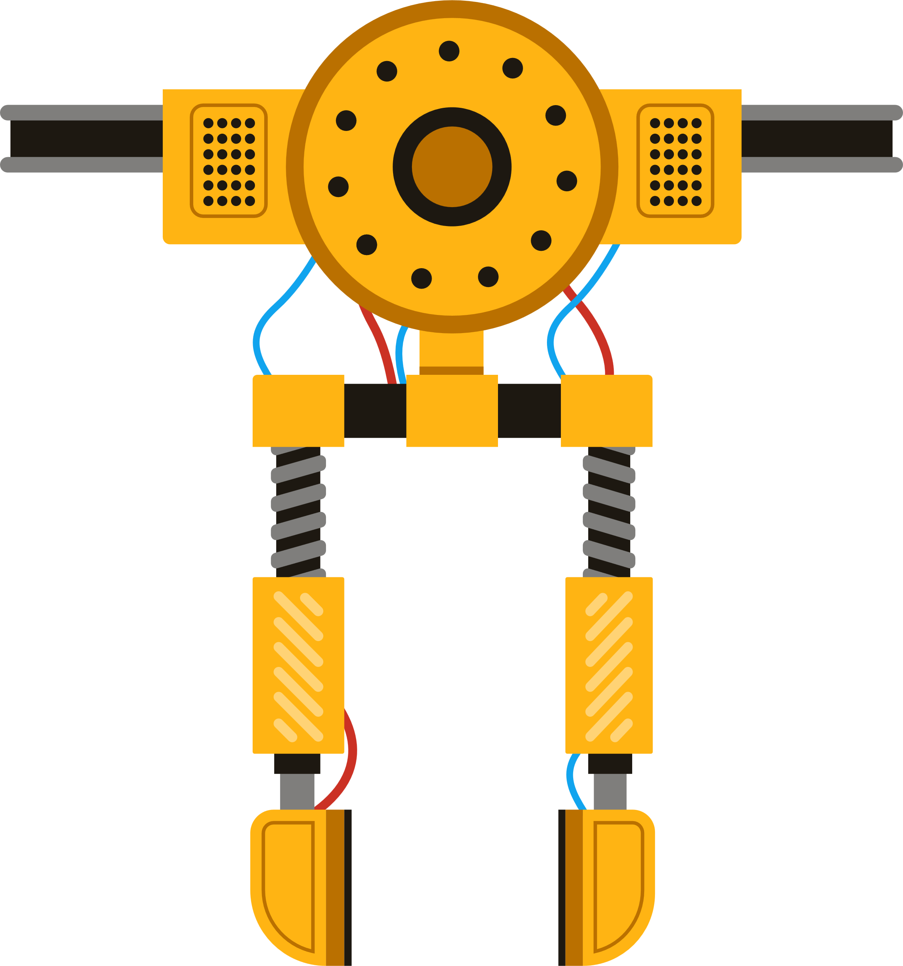
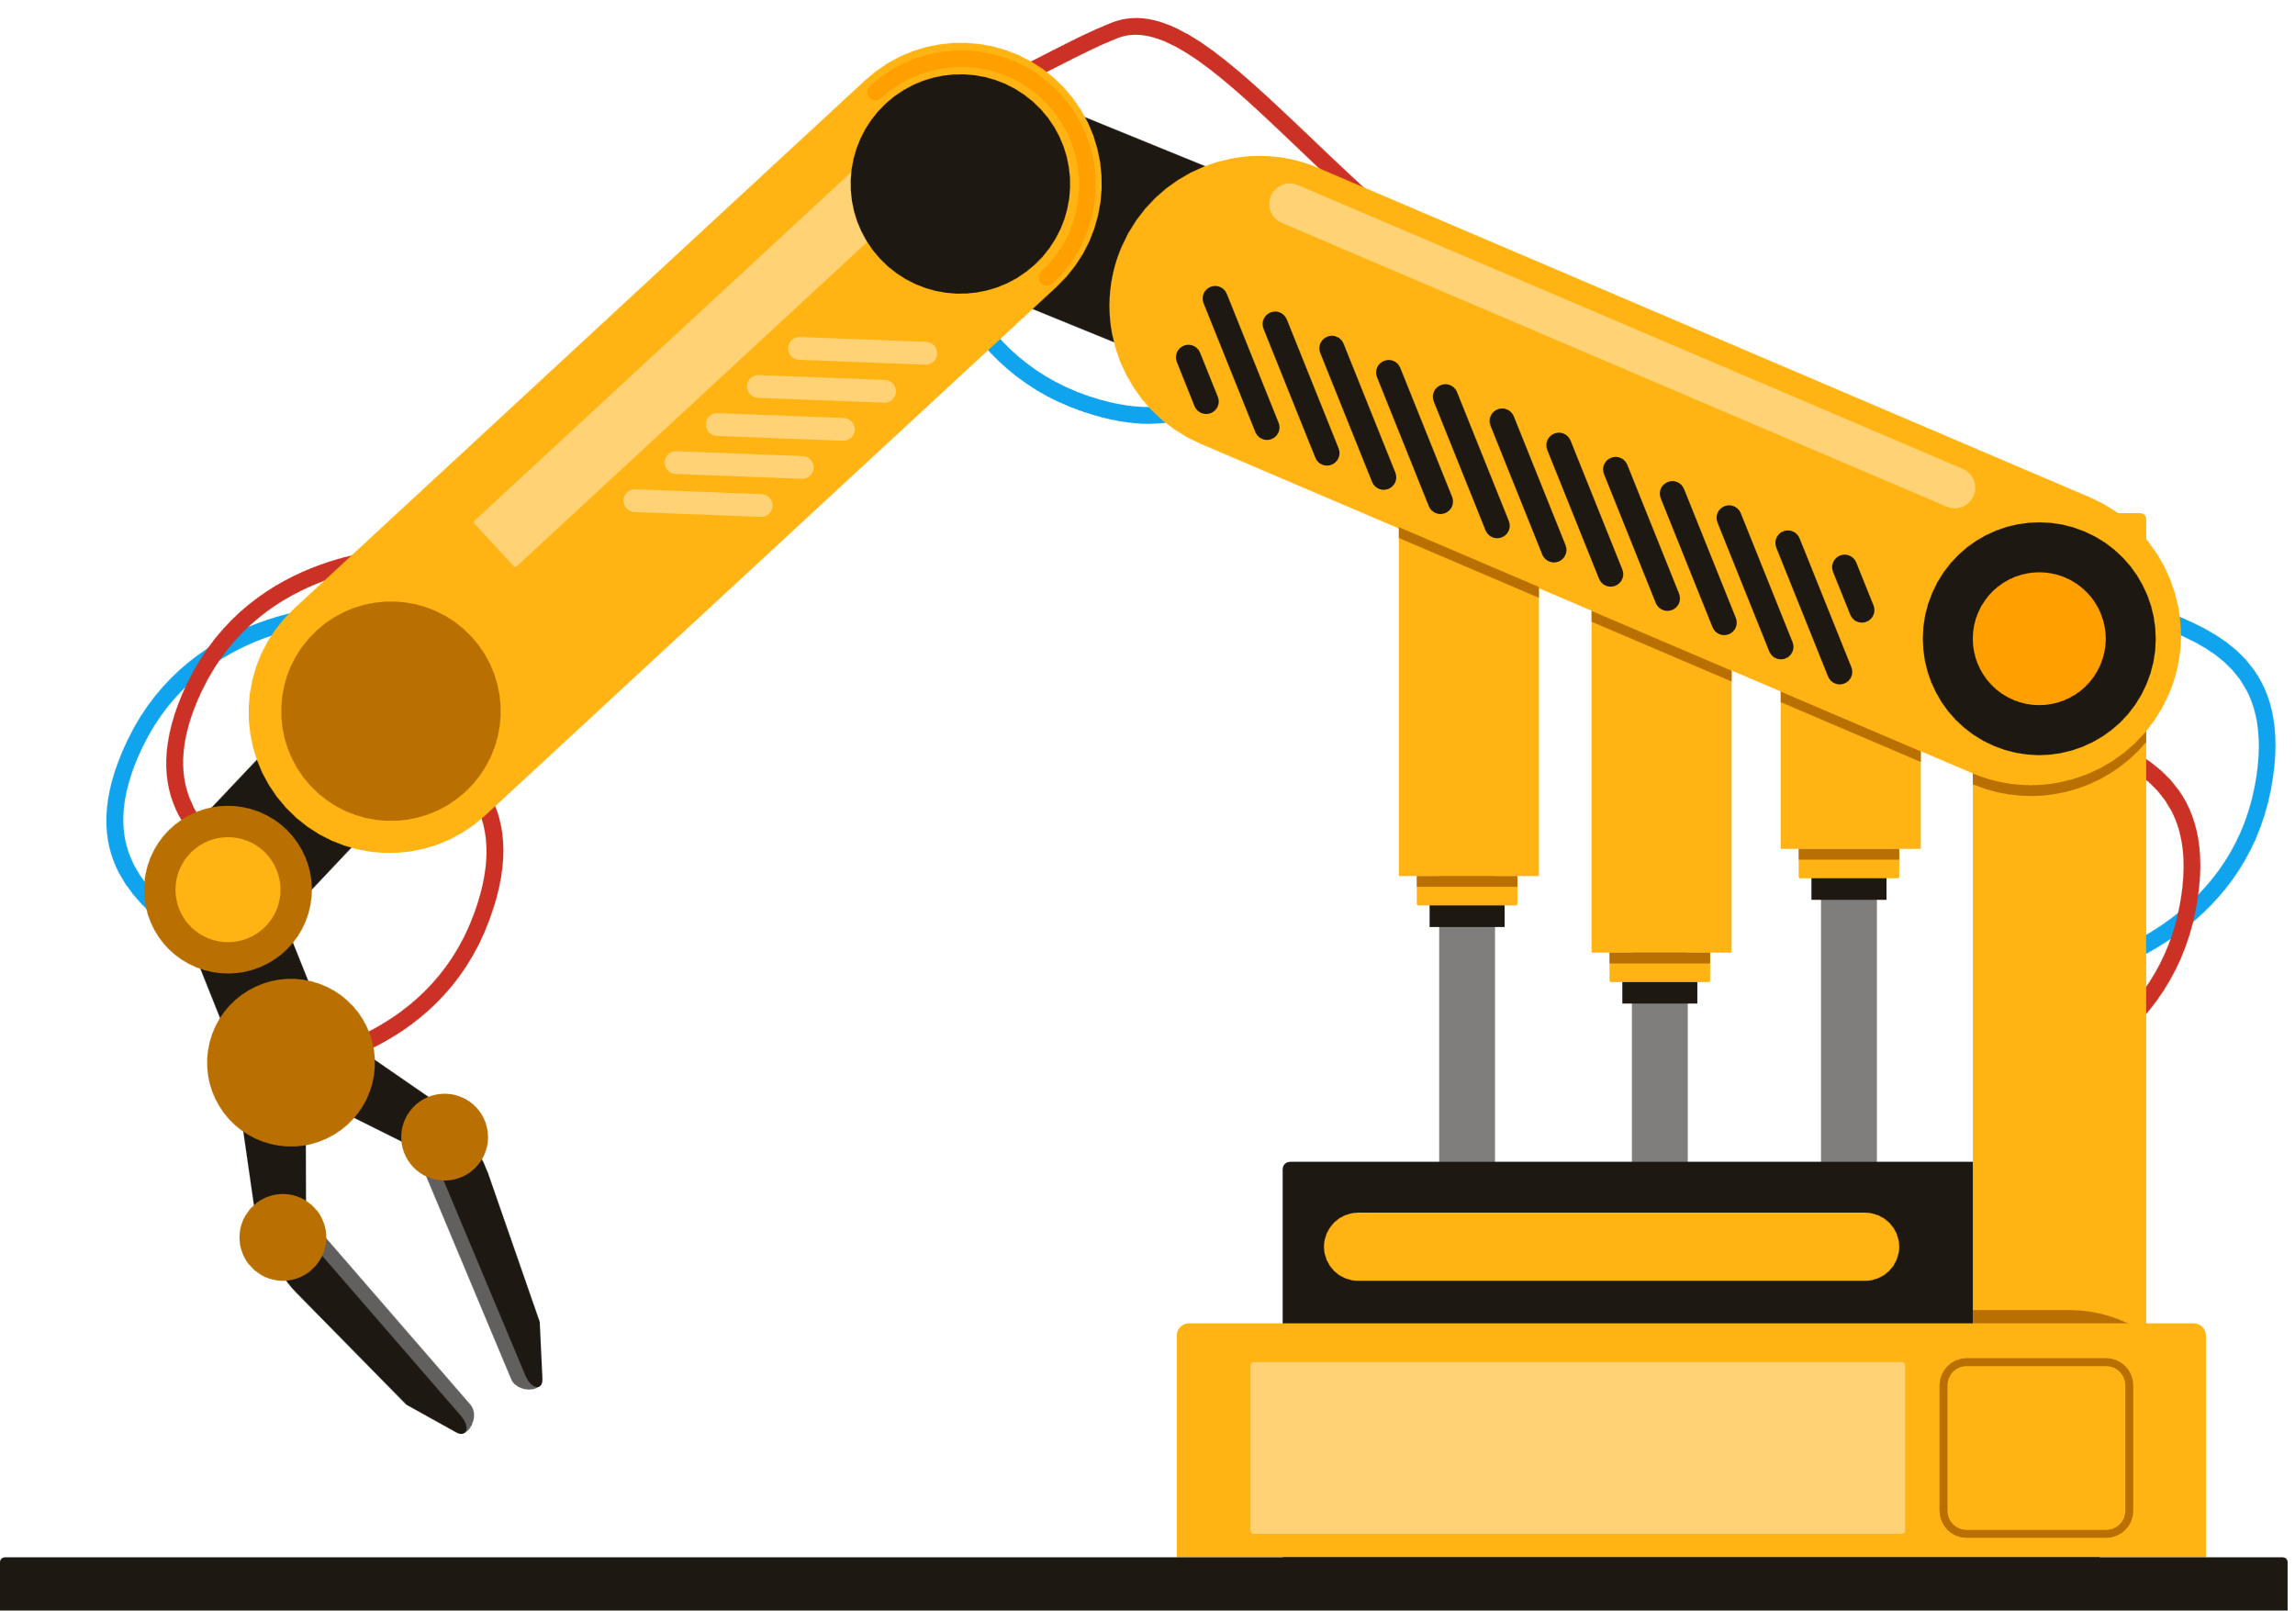

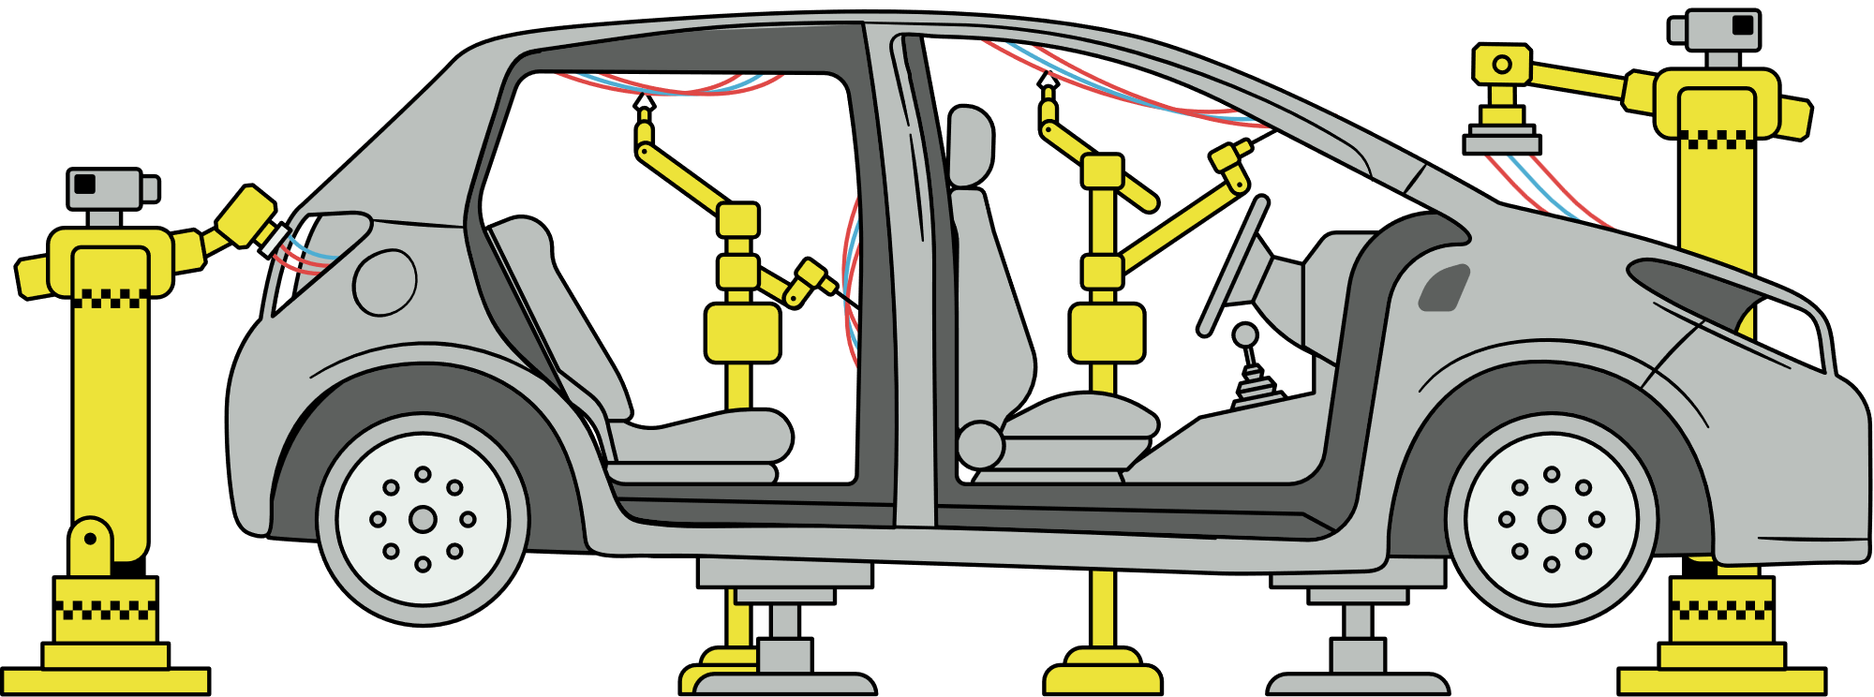
Introduction to Fusion
workshop

Slide 2
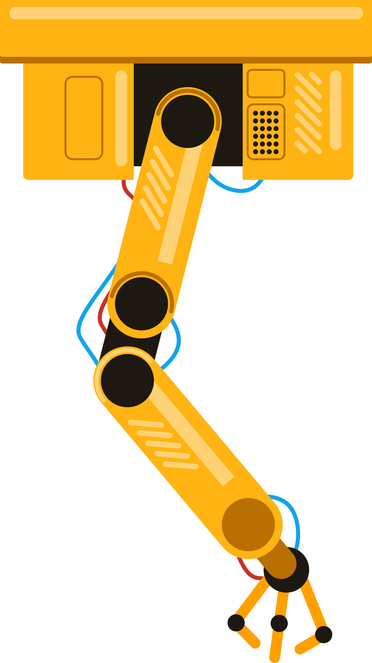

What is Fusion 360?
Fusion 360 is a cloud-based platform for 3D design, engineering, and manufacturing, created by Autodesk.
Integrates CAD (design), CAE (simulation), and CAM (manufacturing) into one software.
Used in industries like mechanical engineering, automotive design, product development, and jewelry making.
For students: Free to use, supports real-time collaboration, and builds skills for industry jobs.

Slide 3
Interface Overview

Slide 4
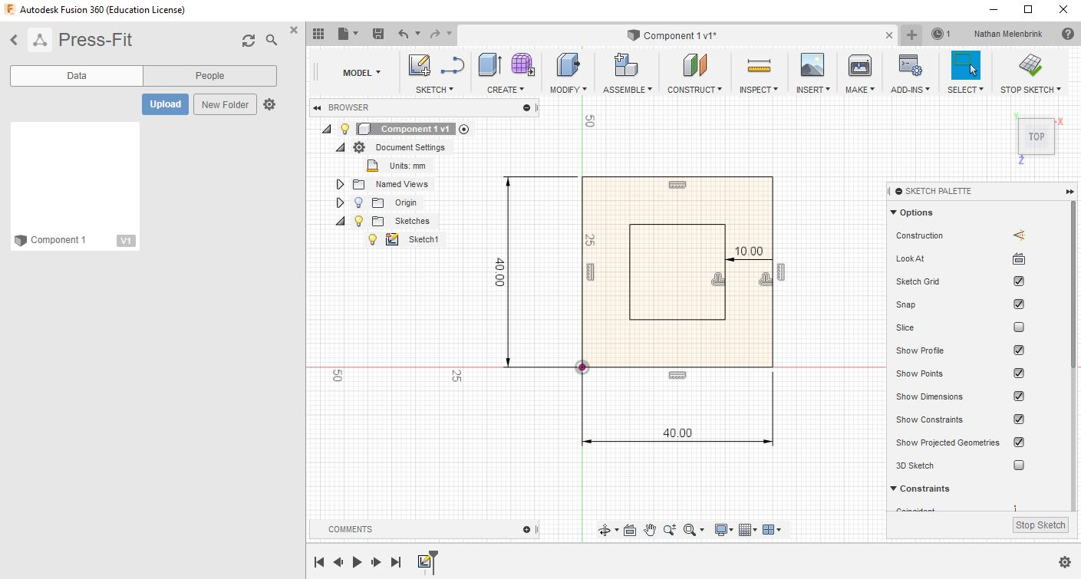
Sketching Essentials
Foundation of all designs – every 3D model starts with a 2D sketch.

Slide 5
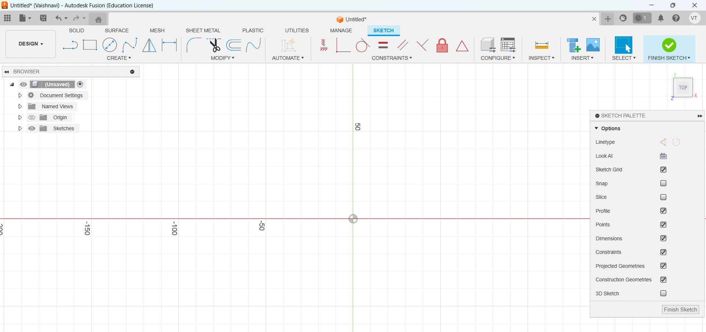
Planes & origin – work on the XY, YZ, or ZX plane, starting from the origin point.
Sketch tools – line, rectangle, circle, arc, spline for complex curves.
Constraints – lock geometry with horizontal, vertical, parallel, equal, tangent, etc.
Dimensions – control exact sizes using the “D” shortcut.

Slide 6
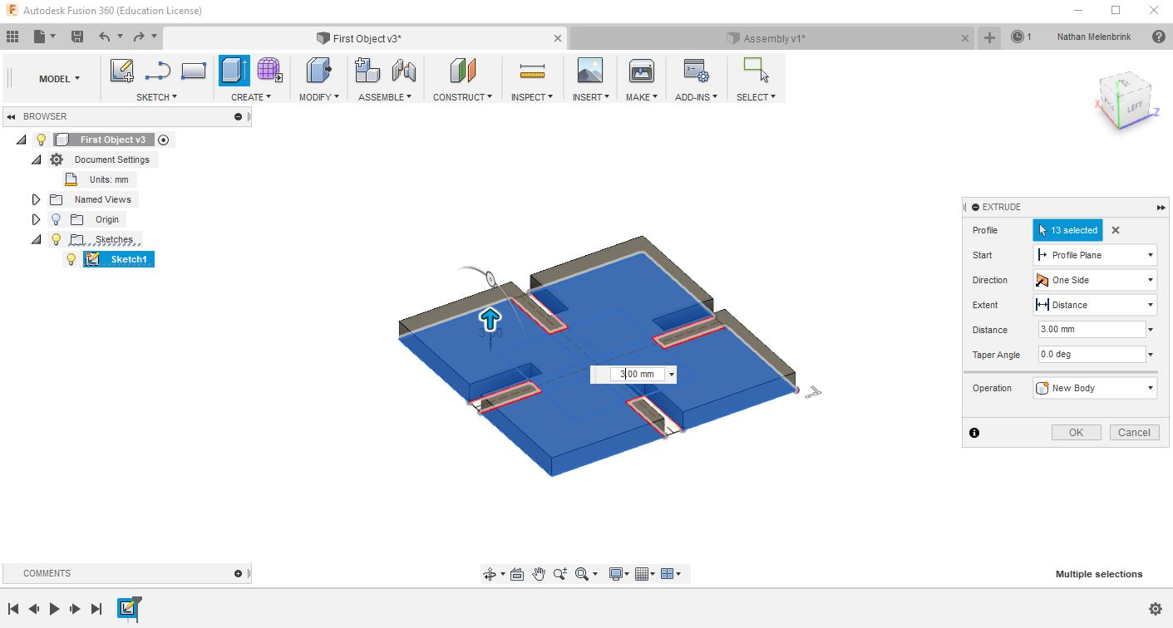
3D Modeling Basics
Extrude – push/pull a sketch to add thickness.

Slide 7
Revolve – spin a sketch around an axis to create round shapes.
Sweep – extrude along a path.
Loft – smoothly connect different shapes.
Modify tools:
Fillet – round an edge.
Chamfer – bevel an edge.
Shell – hollow out a part.
Pattern – repeat a feature in circular/rectangular layouts.

Slide 8
Assemblies & Joints
Bodies: Represent distinct solid objects within a single part file. They are useful for basic modeling and prototyping, but lack advanced assembly features.
Components: Self-contained parts that can have their own sketches, features, and origin. Components are essential for assembling complex designs, enabling motion and relationship definition between parts.

Slide 9
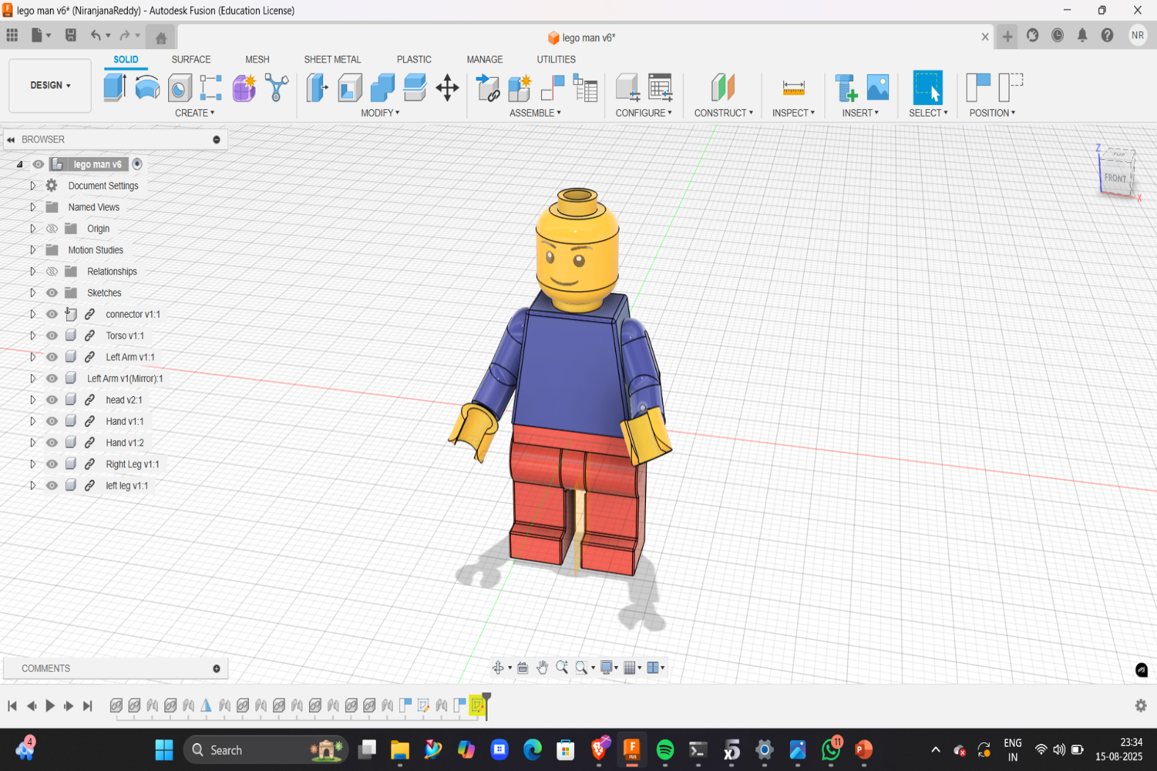
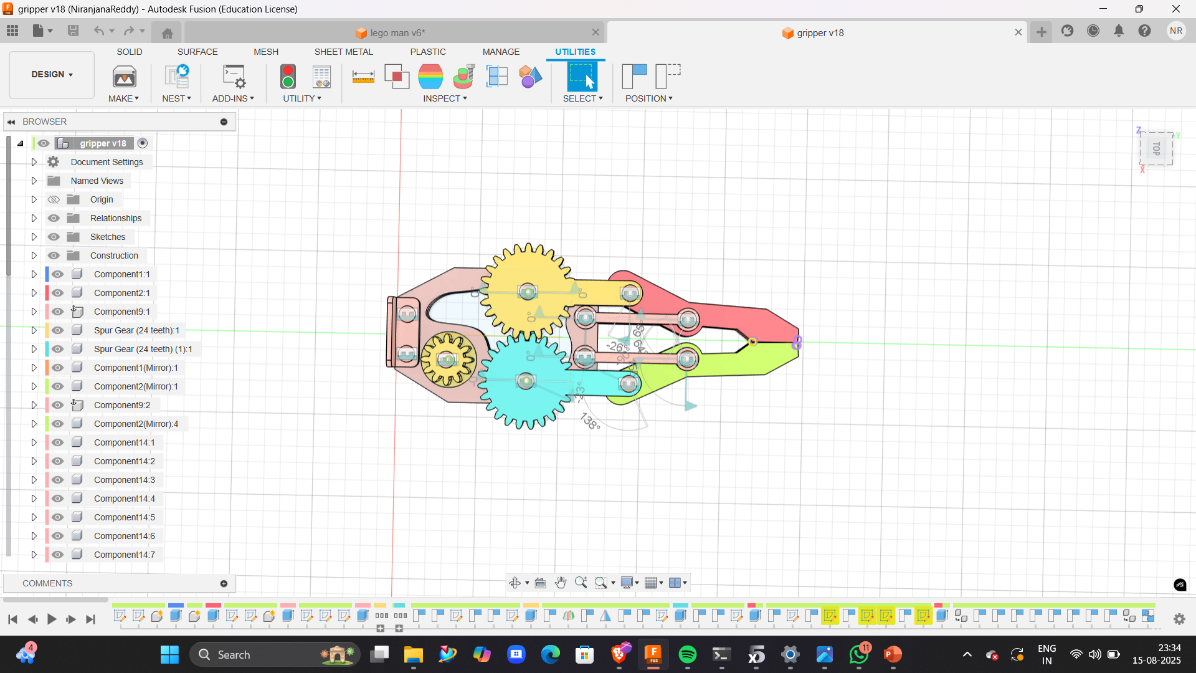

Assembly

Slide 10
Joints
Joints connect components in assemblies to define movement or constraint relationships.
Joints connect components and define movement.
Rigid – no movement.
Revolute – rotate around one axis.
Slider – move in a straight line.

Slide 11
Rendering & Appearance
Change materials: Apply realistic properties like metal, plastic, wood, glass.
Textures & colors: Customize finishes, patterns, and colors for visual appeal.
Rendering types:
In-Canvas Render – instant preview inside the workspace.
High-Quality Render – detailed output for presentations.

Slide 12
Applications & Best Practices
Where Fusion 360 is used:
Mechanical engineering: Machine parts, assemblies, prototypes.
Automotive: Custom components, fixtures, concept models.
Product design: Consumer goods, electronics housings, packaging.
Jewelry & art: Precision modeling, custom engraving.
Education & research: Prototyping and testing student projects.

Slide 13
Welcome to QnA Time

Slide 14
Our Team

Slide 15
Thank You

